Slide 1
ML Final Project
20155134 이준오
20155064 남진우
20155009 구자빈

Slide 2
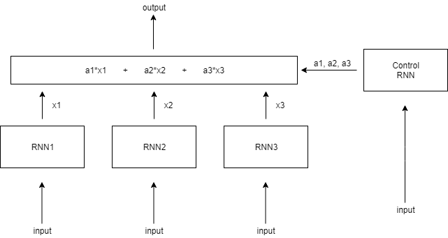
Introduction
DARNN

Slide 3
Motivation

Slide 4
Model
DARNN

Slide 5
Loss Function
Objective 1
- Make one weight a significant
Objective 2
- Distribute cell usage equally

Slide 6
Experiment

Slide 7
Conclusion

